Slide 1


DEPARTMENT OF COMPUTER SCIENCE AND ENGINEERING
20CS7503 & DESIGN PROJECT 3
CYCLE 2 REVIEW PRESENTATION
Batch No: 01
Date: 29.10.2025
Session: FN

Slide 2
NATURAL LANGUAGE TO SQL DATA
Guide Name:
Ms. V. Sowmiya, M.E.,
Team Members:
M.Kishore (81172210478)
PL.Nachiappan (811722104097)
R.Raseen raja (811722104305)

Slide 3
OBJECTIVE OF THE PROJECT
To abstract the underlying complexity of database systems into an intuitive and simplified interaction model.
To leverage Natural Language to SQL (NL2SQL) techniques for enabling seamless query formulation by non-technical end-users.
To democratize data access by empowering users without technical expertise to retrieve, interpret, and utilize data-driven insights.
To enhance usability and efficiency in database interaction through natural language processing–driven query generation.
To transform raw database records into structured, actionable information, facilitating improved comprehension and analytical decision-making.

Slide 4
INTRODUCTION
Database interactions can be made more intuitive and user-friendly through abstraction.
Natural language processing can bridge the gap between non-technical users and complex SQL queries.
Simplifying database interactions can empower non-technical users to extract insights and make data-driven decisions.
Complex databases can be distilled into actionable information, making it easier to understand and analyze data.
By combining natural language processing with database abstraction, we can create a more accessible and efficient data interaction experience.

Slide 5
LITERATURE SURVEY
TITLE | AUTHORS | TECHNOLOGY USED | DRAWBACKS
Natural Language to SQL: Review of LLM-based Text-to-SQL Systems | Ali Mohammadjafari, Anthony S. Maida | Seq2SQL Algorithm | Heavy reliance on LLMs; performance depends on model size and training data.
Making SQL Easier to Infer from Natural Language | Yujian Gan, Xinyun Chen, Jinxia Xie, Matthew Purver, John R. Woodward, John Drake, Qiaofu Zhang | NatSQL (a simplified SQL intermediate representation) | Performance highly depends on mapping accuracy from natural language to NatSQL
Natural language to SQL: Where are we today? | Hyeonji Kim, Byeong-Hoon So, Wook-Shin Han, Hongrae Lee | Comprehensive survey and taxonomy of NL2SQL methods | Being a survey, it does not propose a novel solution but summarizes existing work
Natural Language to SQL Queries Generation using NLP Techniques | Mohammed Osama Shaikh, Fiza Shaikh, Dr. Irfan Landge | Focused on English-to-SQL translation for relational databases | Less emphasis on execution accuracy; more on syntactic query generation.

Slide 6
LITERATURE SURVEY
TITLE | AUTHORS | TECHNOLOGY USED | DRAWBACKS
Seq2SQL: Generating Structured Queries from Natural Language using Reinforcement Learning | Victor Zhong, Caiming Xiong, Richard Socher | Seq2Seq with pointer network; SQL-specific sketch; execution-guided policy-gradient RL to handle unordered SQL parts; trained on WikiSQL | Reinforcement learning adds training complexity and instability.
RAT-SQL: Relation-Aware Schema Encoding and Linking for Text-to-SQL Parsers | Bailin Wang, Richard Shin, Xiaodong Liu, Oleksandr Polozov, Matthew Richardson | Relation-aware self-attention (Transformer) over question + DB schema | Requires large computational resources for training/inference
Making SQL Easier to Infer from Natural Language | Yujian Gan, Xinyun Chen, Jinxia Xie, Matthew Purver, John R. Woodward, John Drake, Qiaofu Zhang | Compatible with Spider benchmark | While NatSQL simplifies SQL generation, it reduces expressive power for handling advanced SQL constructs.

Slide 7





EXISTING SYSTEM
SQL Workspace
Data Engineer
SQL Connective
Query

Slide 8
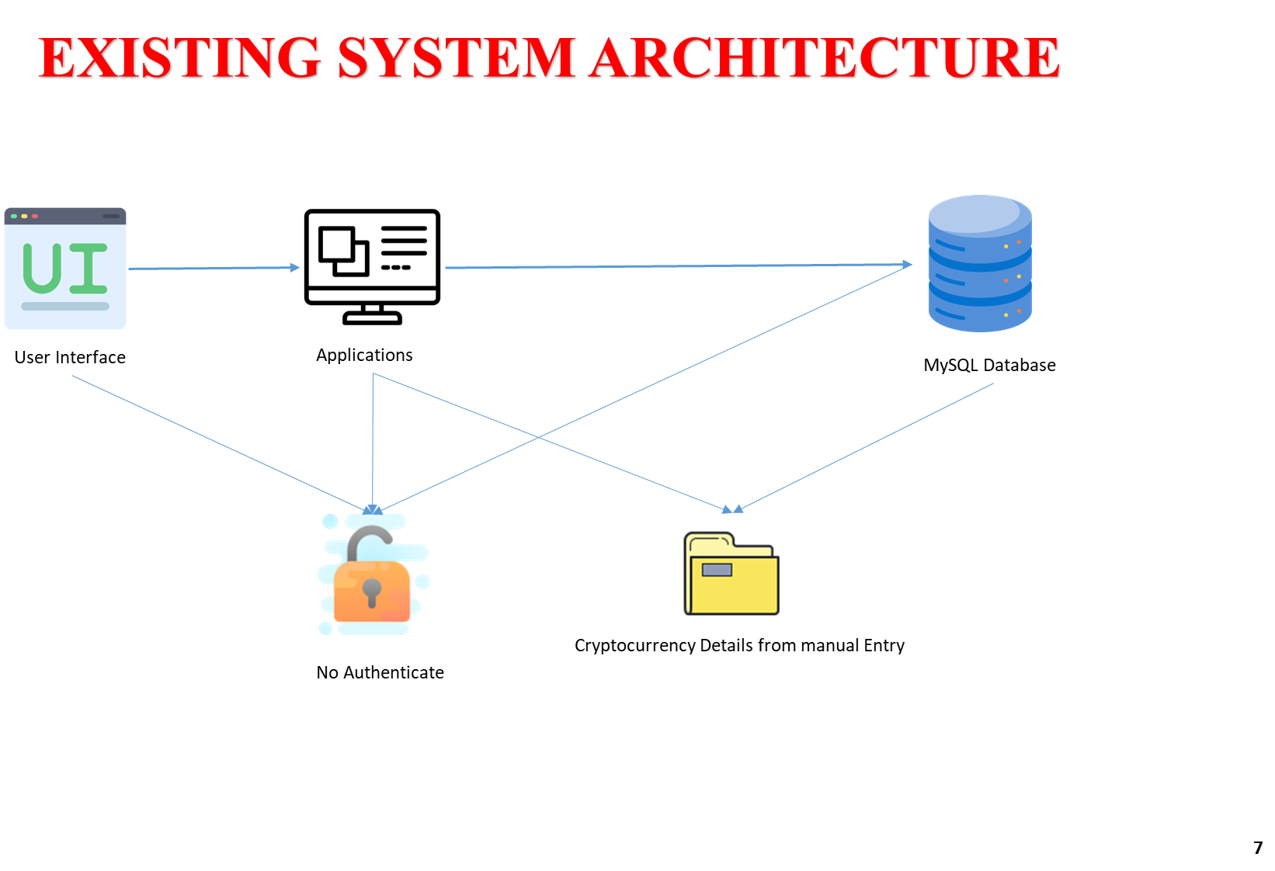



PROPOSED SYSTEM
Text
Input
API
Deliver to
appropriate model
Data from DataBase
Query Generated

Slide 9
SOFTWARE AND HARDWARE REQUIREMENTS
HARDWARE
1.Processor : i5 processor 2.6.0 GHZ
2. RAM : 8GB
3. Hard Disk : Min 128GB
4. Keyboard : standard keyboard
SOFTWARE
1. Ollama
2. VS Code
3. Python
4. streamlit

Slide 10
MODULES
1. Data base module
2. User interface module
3. Analyze module
4. NLP to SQL module
5. Perform CRUD module

Slide 11
1. Database Module
1. Data storage and retrieval
2. Ensures data integrity and security
3. Supports scalable data management
4. Optimizes query performance
5. Handles data backup and recovery

Slide 12
2. User Interface Module
1. Intuitive and user-friendly design
2. Supports multiple user roles and access levels
3. Provides real-time feedback and updates
4. Customizable to meet specific user needs
5. Accessible on various devices and platforms.

Slide 13
3. Analyze Module
The NLP is being processes and breaks down into tokens
These Tokens are further check into dictionary called vocab
Finally it will use Vector embedding to check word.
In short this entire module is named as RAG(Retrieval Augmented Generation).

Slide 14
4.NLP to SQL Module
1. Translates natural language queries to SQL
2. Supports multiple natural languages
3. Handles complex queries and subqueries
4. Continuously learns and improves query accuracy
5. Enables non-technical users to interact with the database.

Slide 15
5. CRUD Module
1. Create: Adds new data to the database
2. Read: Retrieves and displays existing data
3. Update: Modifies existing data
4. Delete: Removes data from the database.

Slide 16
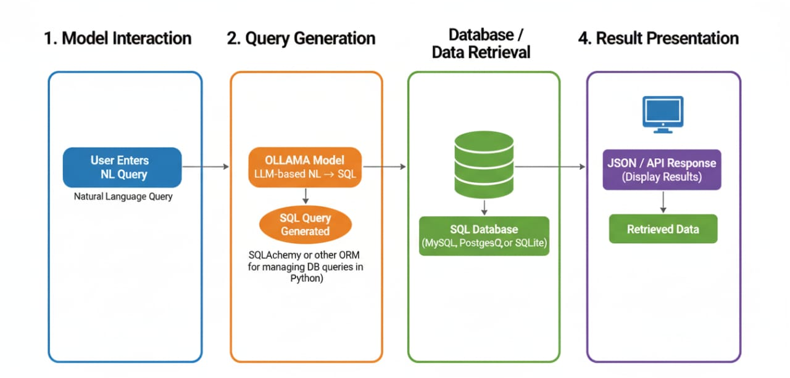
TECHNOLOGY USED

Slide 17
IMPLEMENTATION OF MODULES
Database Module – Stores project data in an SQL database and is accessed through Python using SQLAlchemy for efficient query execution.
User Interface Module – Built with HTML/CSS/JS (or React) to take natural language input from users and display retrieved results.
Analyze Module – Processes user input in Python, validates queries, and manages communication between UI, OLLAMA, and the database.
NLP to SQL Module – Uses the OLLAMA API to convert natural language queries into structured SQL commands.
Perform CRUD Module – Executes Create, Read, Update, and Delete operations on the database and returns results to the user.

Slide 18
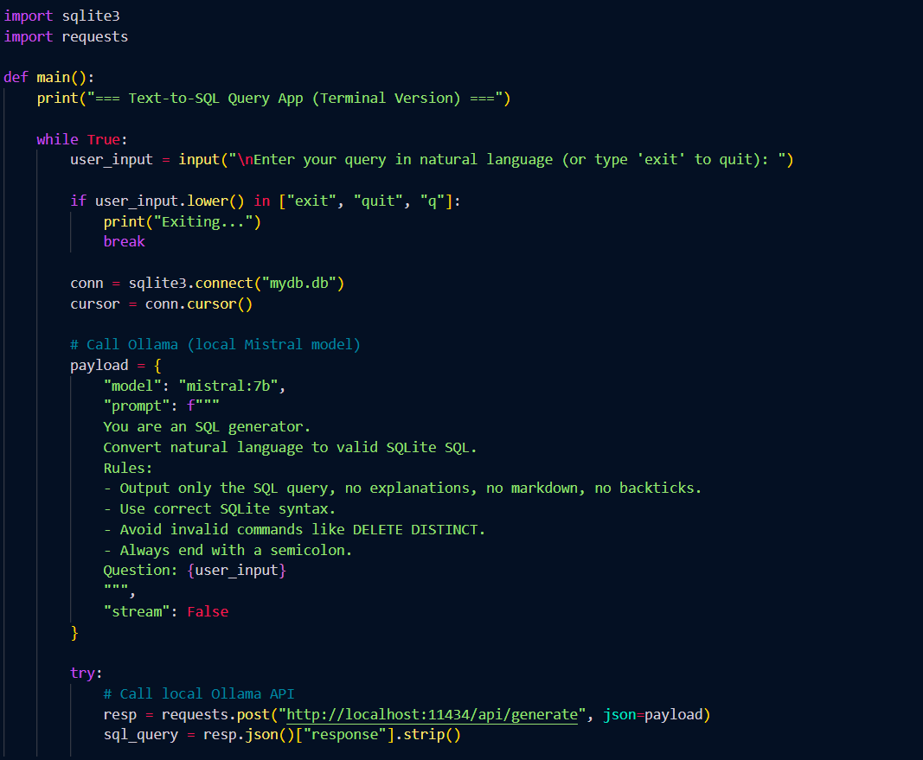
IMPLEMENTATION

Slide 19
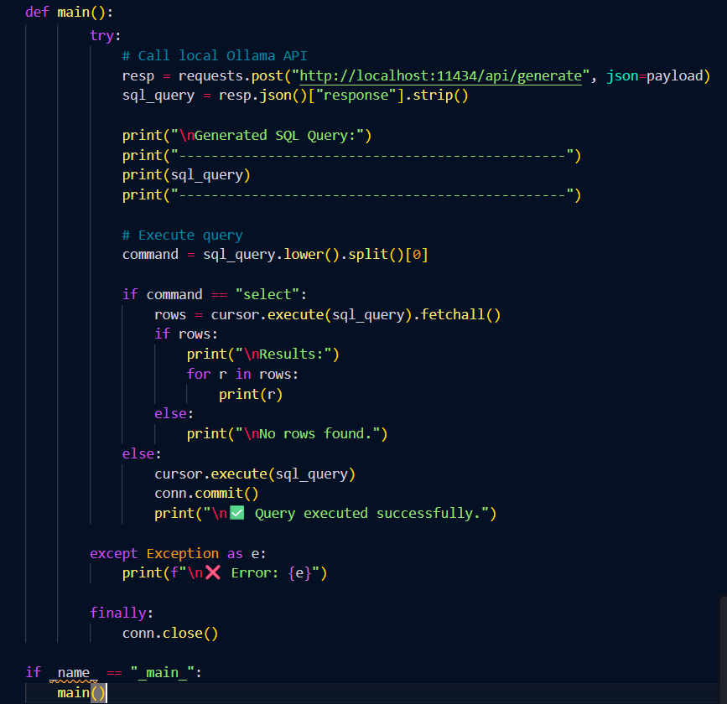
IMPLEMENTATION

Slide 20
OUTPUT

Slide 21
REFERENCES
Ali Mohammadjafari, Anthony S. Maida, “Natural Language to SQL: Review of LLM-based Text-to-SQL Systems,” arXiv preprint, February 2025.
Mohammed Osama Shaikh, Fiza Shaikh, Irfan Landge, “Natural Language to SQL Queries Generation using NLP Techniques,” International Journal of Advanced Research in Science, Communication and Technology (IJARSCT), Volume 4, Issue 7, April 2024.
Jiaxi Yang, Binyuan Hui, Min Yang, Jian Yang, Junyang Lin, Chang Zhou: “Synthesizing Text-to-SQL Data from Weak and Strong LLMs”, ACL 2024.
Ruoxi Sun, Sercan Ö. Arik, Alex Muzio, Lesly Miculicich, Satya Gundabathula, Pengcheng Yin, Hanjun Dai, Hootan Nakhost, Rajarishi Sinha, Zifeng Wang, Tomas Pfister: “SQL-PaLM: Improved Large Language Model Adaptation for Text-to-SQL (extended)”, 2023.
Linyong Nan, Yilun Zhao, Weijin Zou, Narutatsu Ri, Jaesung Tae, Ellen Zhang, Arman Cohan, Dragomir Radev: “Enhancing Text-to-SQL Capabilities of Large Language Models: A Study on Prompt Design Strategies”, Findings of ACL/EMNLP 2023.
Chang Gao, Bowen Li, Wenxuan Zhang, Wai Lam, Binhua Li, Fei Huang, Luo Si, Yongbin Li: “Towards Generalizable and Robust Text-to-SQL Parsing”, Findings of ACL/EMNLP 2022.
Jun Wang, Patrick Ng, Alexander Hanbo Li, Jiarong Jiang, Zhiguo Wang, Ramesh Nallapati, Bing Xiang, Sudipta Sengupta: “Improving text-to-SQL semantic parsing with fine-grained query understanding”, 2022.
Yujian Gan, Xinyun Chen, Jinxia Xie, Matthew Purver, John R. Woodward, John Drake, Qiaofu Zhang, “Making SQL Easier to Infer from Natural Language,” arXiv preprint, available at https://github.com/ygan/NatSQL, 2021.
Bailin Wang, Richard Shin, Xiaodong Liu, Oleksandr Polozov, Matthew Richardson, “RAT-SQL: Relation-Aware Schema Encoding and Linking for Text-to-SQL Parsers,” Proceedings of the 58th Annual Meeting of the Association for Computational Linguistics (ACL), 2020.
Hyeonji Kim, Byeong-Hoon So, Wook-Shin Han, Hongrae Lee, “Natural Language to SQL: Where are we today?” Proceedings of the VLDB Endowment (PVLDB), Volume 13, No. 10, 2020

Slide 22
THANK YOU

